Slide 1

Sprint #4
IGVC
AutoMav
Dario Ugalde, Awet Tesfamariam, Andrew Break, Amgad Alamin, Warren Smith

Slide 2
Sprint Goal
Fix the Project Charter, System Requirements Specification(SRS), and Architectural Design Specification (ADS)
Parts Inventory
Order Parts
Frame Design

Slide 3
Sprint Backlog (Design)
Item | Time Estimate (hours) | Time Taken (hours)
Project Charter | 4 | 3
System Requirements Specification | 3 | 0
Architecture Design Specification | 3 | 5
Parts Inventory | 3 | N/A
Frame Design | 5 | 3

Slide 4
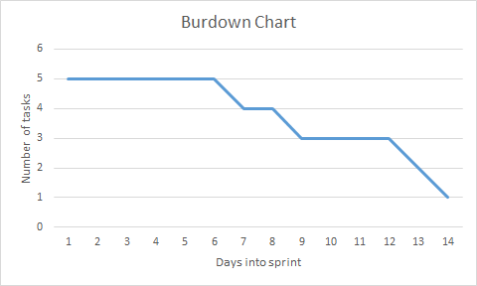
Burndown Chart

